Slide 1
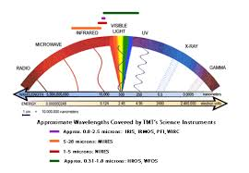
Electromagnetic Waves

Slide 2
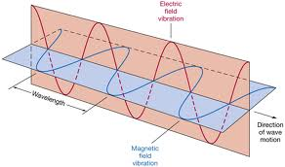
An electromagnetic wave a disturbance that transfers energy through a field.
Electromagnetic waves are called EM waves
There are electromagnetic waves all around us
Light is made up of electromagnetic waves. When ever you feel the heat from the sun you are experiencing electromagnetic waves
How are they different from mechanical waves?

Slide 3
How EM waves form
EM waves occur when electrically charged particles move. The charged particles exert an
electric force on each other. They now have electric fields. A moving charged particle
creates Magnetic force. A moving charged particles also has a magnetic field around it.

Slide 4
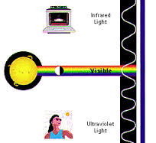
Sources of EM Waves
Most of the EM Waves come from the Sun. Other Stars also give off EM Waves but are to far away to affect us

Slide 5
EM waves can travel in a vacuum
Energy that moves in the form of EM waves are called radiation
EM waves do not need a material medium to travel

Slide 6
How EM waves travel
EM waves spread outward from the source until they until they reach something that interferes with them.
The farther the waves move from their source, the more spread out they become.
As they spread out the waves have less and less energy
Only a small amount of the suns radiation reaches earth , but it is still enough to sustain life on the planet
The sun’s radiation travels 93 million miles to reach earth ( takes about 8 minutes to reach Earth)

Slide 7
How fast do EM waves Travel?
In a vacuum EM waves travel about 186 miles per second.( 7 times the distance around earth (This is also called the speed of light)
The sun is 8.3 light minutes away from the Earth

Slide 8
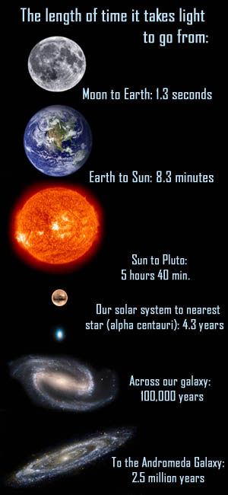
Speed of Light

Slide 9
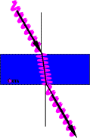
Electromagnetic waves can interact with material medium
EM waves respond to a medium by reflecting, refracting, or diffracting. The direction of the wave changes and the direction in which the energy transferred also changes

Slide 10
EM Waves transfer energy
When in a vacuum EM waves only transfer energy by moving potential energy from one place to another.
EM waves interact with matter the energy can be converted into many different forms

Slide 11
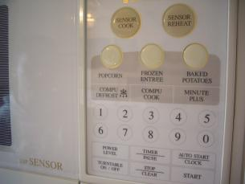
Converting Energy from one form to another
Microwave
A device on a microwave produces microwaves. They are then sent to a reflecting fan
The blades of a fan deflect the microwaves in many directions
Microwaves move through the air without transferring energy to the air
Microwaves transfer energy transfers the energy to the water molecules inside the food in the form of heat

Slide 13
The Electromagnetic Spectrum

Slide 14
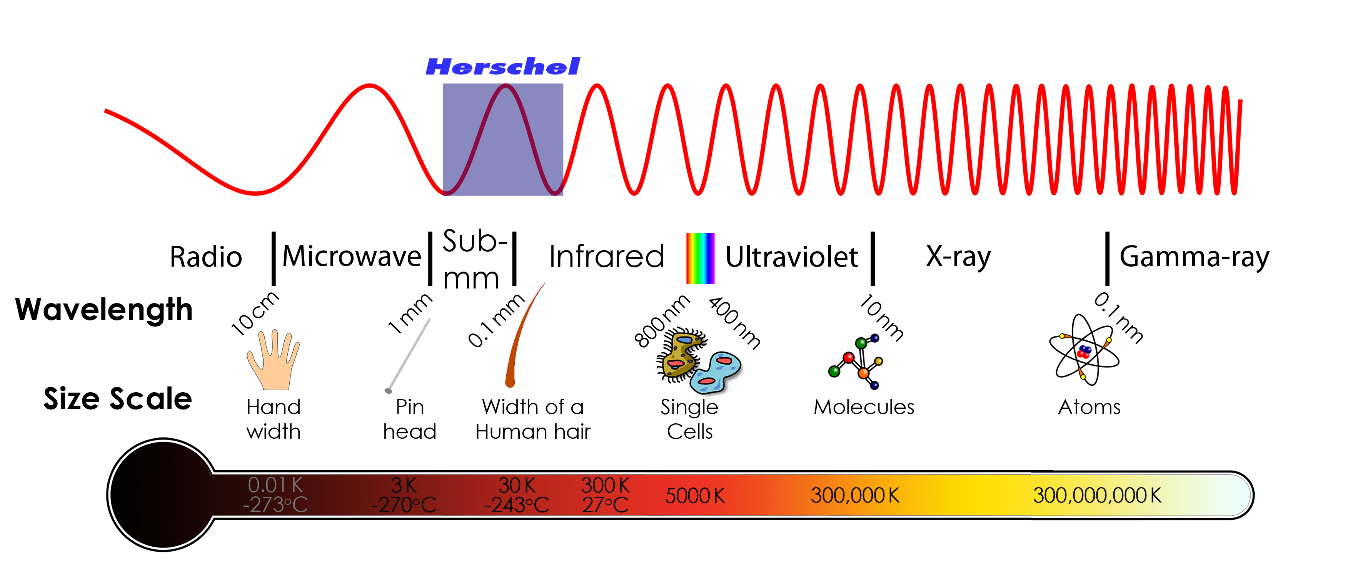
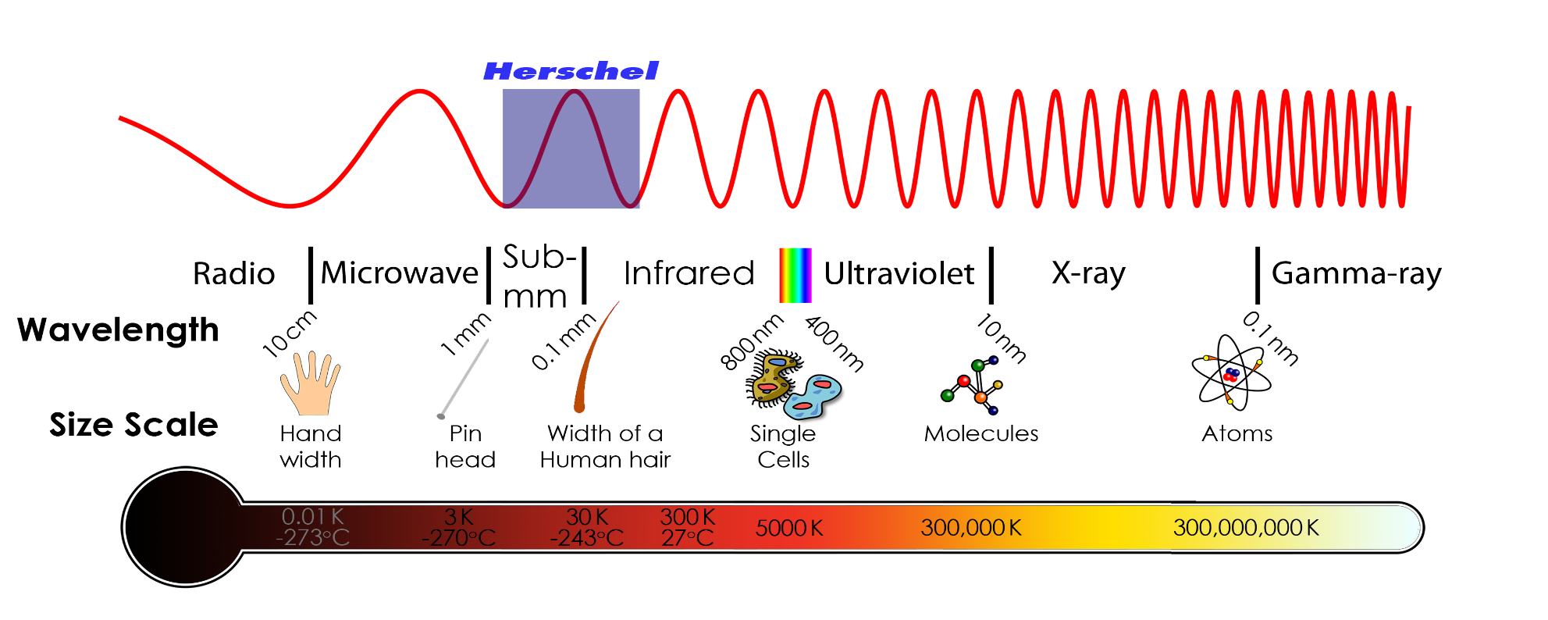
Define Electromagnetic Spectrum
The range of all EM waves is know as the Electromagnetic Spectrum
On the left are waves that have he longest wavelength and the lowest frequency

Slide 15
The Electromagnetic Spectrum
On the right the wavelengths become shorter
and the frequency and energy becomes higher

Slide 16
Radio waves
Have the longest wavelength and the lowest Frequency

Slide 17
Microwaves – shorter wavelength, higher frequencies and higher energy than Microwaves. Uses: radar and cell phones

Slide 18
Visible light – Is the part of the spectrum that the human eye can see. Only about 1/100,000 of the complete EM Spectrum

Slide 19
Infrared light is between microwaves and visible light on the EM spectrum. Often called heat rays. You can feel it as warmth from the sun

Slide 20
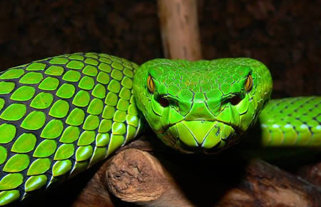
Some animals can see infrared light
Viper Snake!!!

Slide 21
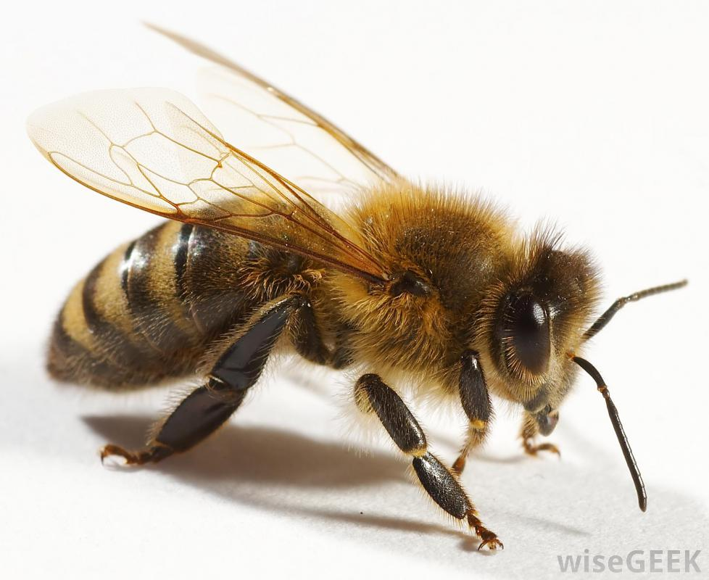
Ultraviolet Light
has higher frequency that visible light. It carries more energy that visible light Use to sterilize instruments because it can damage cells
Some animals can see ultra violet light

Slide 22
X-Rays and Gamma Rays
Have high Frequency and High Energy

Slide 23
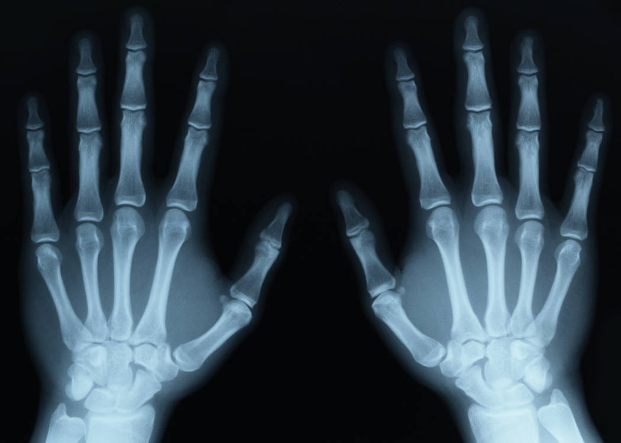
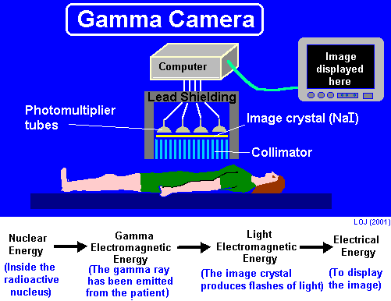
Uses of X-rays and Gamma Rays

