Slide 1
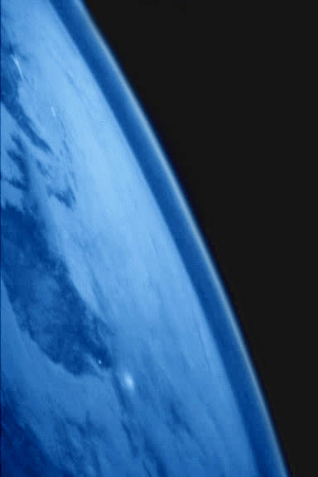
The Earth’s Atmosphere

Slide 2
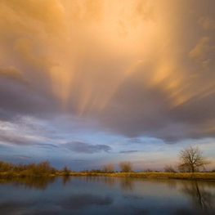
Atmosphere
The atmosphere is a mixture of gases that surrounds the earth

Slide 3
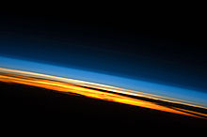
Composition of the Atmosphere
The atmosphere is a mixture of …
nitrogen (78%)
oxygen (21%)
and other gases (1%)
Argon
Carbon dioxide
Water vapor

Slide 4
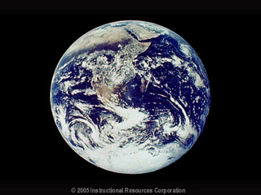
Just some facts…
Nitrogen and oxygen make up 99% of the air we breathe
Oxygen is produced mainly by plants
Nitrogen is released into the atmosphere by volcanic eruptions and when dead plants and animals decay

Slide 5
Air Pressure and Altitude
Air pressure
the measure of the force with which the air molecules push on a surface.
Altitude
Height of an object above the earth’s surface

Slide 6
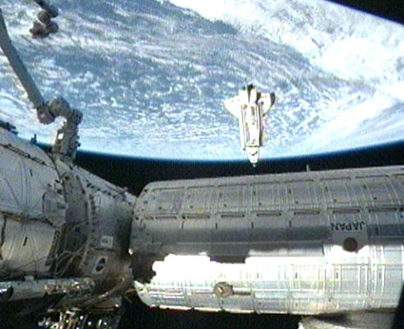
As you move farther away from the earth surface air pressure decreases

Slide 7
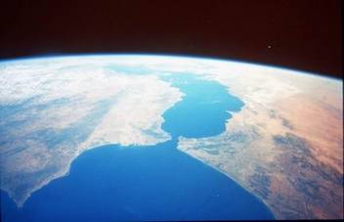
Temperature and Altitude
As you pass through the atmosphere, air temperature changes between warmer and colder conditions due to the way solar radiation is absorbed in each of the layers of the atmosphere

Slide 8
Layers of the Atmosphere
The earth’s atmosphere is divided into four layers based on temperature changes
Troposphere
Stratosphere
Mesosphere
Thermosphere (contains the ionosphere and the exosphere)

Slide 9
Troposphere
Lowest layer of the atmosphere
Closest to the earth
Contains 90% of the atmosphere’s total mass
Layer in which we live
Found in the troposphere
Carbon dioxide
Water vapor
Clouds
Air pollution
Weather
Life forms

Slide 10
Troposphere
The temperature decreases as the altitude increases

Slide 11
Stratosphere
Layer above the troposphere
Air is thin and contains little moisture
Contains the ozone(molecule made up of three oxygen atoms
Ozone absorbs solar energy in the form of ultraviolet radiation and protects life at the earth’s surface

Slide 12
Stratosphere
The lower level of the stratosphere is very cold.
The temperature rises with increasing altitude

Slide 13
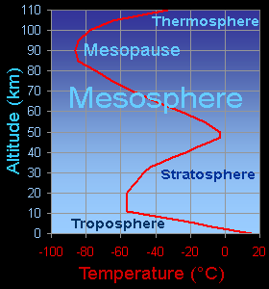
Mesosphere
Coldest layer of the atmosphere
Temperature drops with increasing altitude

Slide 14
Thermosphere
The uppermost layer of the atmosphere
Temperature increases with altitude because many of the gases are absorbing solar radiation. Temperatures can reach 1,700 degrees Celsius

Slide 15
Does not feel hot in the thermosphere!!!! Why?
Although the measured temperature is very hot, the thermosphere would actually feel very cold to us because the total energy of only a few air molecules residing there would not be enough to transfer any appreciable heat to our skin.
Wow!!!!!!

Slide 16
Thermosphere
This is an image of the space shuttle as it is orbiting around the Earth. The space shuttle orbits in the thermosphere of the Earth.

Slide 17
Thermosphere
The Thermosphere is so big that it is divided into two additional parts: the Ionosphere and the Exosphere.

Slide 18
Ionosphere
The ionosphere is located in the upper mesosphere and lower thermosphere
The absorption of ultraviolet rays causes gas particles to become electrically charged particles called ions

Slide 19
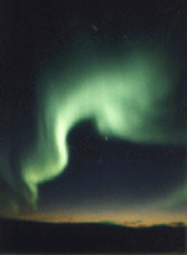
Ionosphere
Aurora borealis and the aurora australis occur in the ionosphere

Slide 20
Ionosphere
Also reflects radio waves such as AM radio waves
When conditions are great AM radio waves can travel around the world after being reflected off the ionosphere

Slide 21
Exosphere
Very high up, the Earth's atmosphere becomes very thin. The region where atoms and molecules escape into space is referred to as the exosphere. The exosphere is the top of the thermosphere

Slide 22
Exosphere
This is a picture which shows the Earth, its atmosphere (the clouds are likely in the troposphere and stratosphere), the limb of the Earth (the dark blue curve/edge which is the mesosphere and thermosphere), and the dark blue to black region of space (where our exosphere extends out to...). Image courtesy of NASA

